Slide 1
ZOMATO DATA ANALYSIS
USING PYTHON

Slide 2
INTRODUCTION
Zomato is an Indian restaurant aggregator and food delivery start-up founded by Deepinder Goyal and Pankaj Chaddah in 2008. Zomato provides information, menus and user-reviews of restaurants, and also has food delivery options from partner restaurants in select cities.
The basic idea of analyzing the Zomato dataset is to get a fair idea about the factors affecting the aggregate rating of each restaurant, establishment of different types of restaurant at different places, Bengaluru being one such city has more than 12,000 restaurants with restaurants serving dishes from all over the world.
With each day new restaurants opening the industry has'nt been saturated yet and the demand is increasing day by day. Inspite of increasing demand it however has become difficult for new restaurants to compete with established restaurants. Most of them serving the same food.
Bengaluru being an IT capital of India. Most of the people here are dependent mainly on the restaurant food as they don't have time to cook for themselves. With such an overwhelming demand of restaurants it has therefore become important to study the demography of a location. What kind of a food is more popular in a locality. Do the entire locality loves vegetarian food. These kind of analysis can be done using the data, by studying different factors.

Slide 3
DATA DESCRIPTION
Data Source:- ZOMATO BANGALORE DATASET
url : contains the url of the restaurant in the zomato website
addres: contains the address of the restaurant in Bengaluru
name: contains the name of the restaurant
online_order: whether online ordering is available in the restaurant or not
book_table: table book option available or not
rate: contains the overall rating of the restaurant out of 5
votes: contains total number of rating for the restaurant as of the above mentioned date
phone: contains the phone number of the restaurant
location: contains the neighborhood in which the restaurant is located
rest_type: restaurant type
dish_liked: dishes people liked in the restaurant
cuisines: food styles, separated by comma
approx_cost(for two people): contains the approximate cost for meal for two people
reviews_lis: list of tuples containing reviews for the restaurant, each tuple
menu_item contains: list of menus available in the restaurant
listed_in(type): type of meal
listed_in(city): contains the neighborhood in which the restaurant is listed

Slide 4
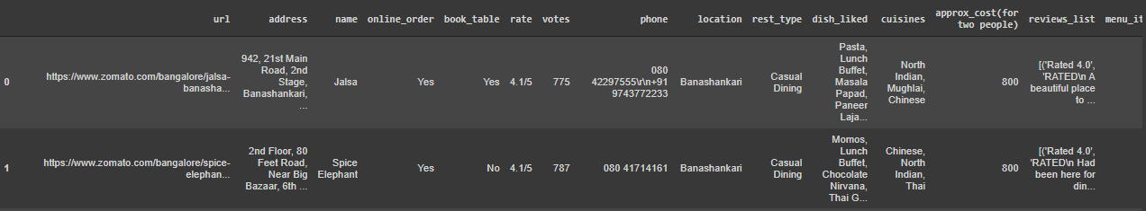
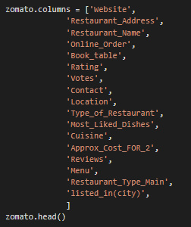
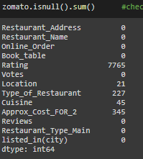

Data Cleaning Summary
Importing the data as Data Frame
Explore the data and check for errors that make data Inefficient for further analysis
Check the datatype and convert as per requirement
Check for Null Values
Replace or Drop Null values

Slide 5
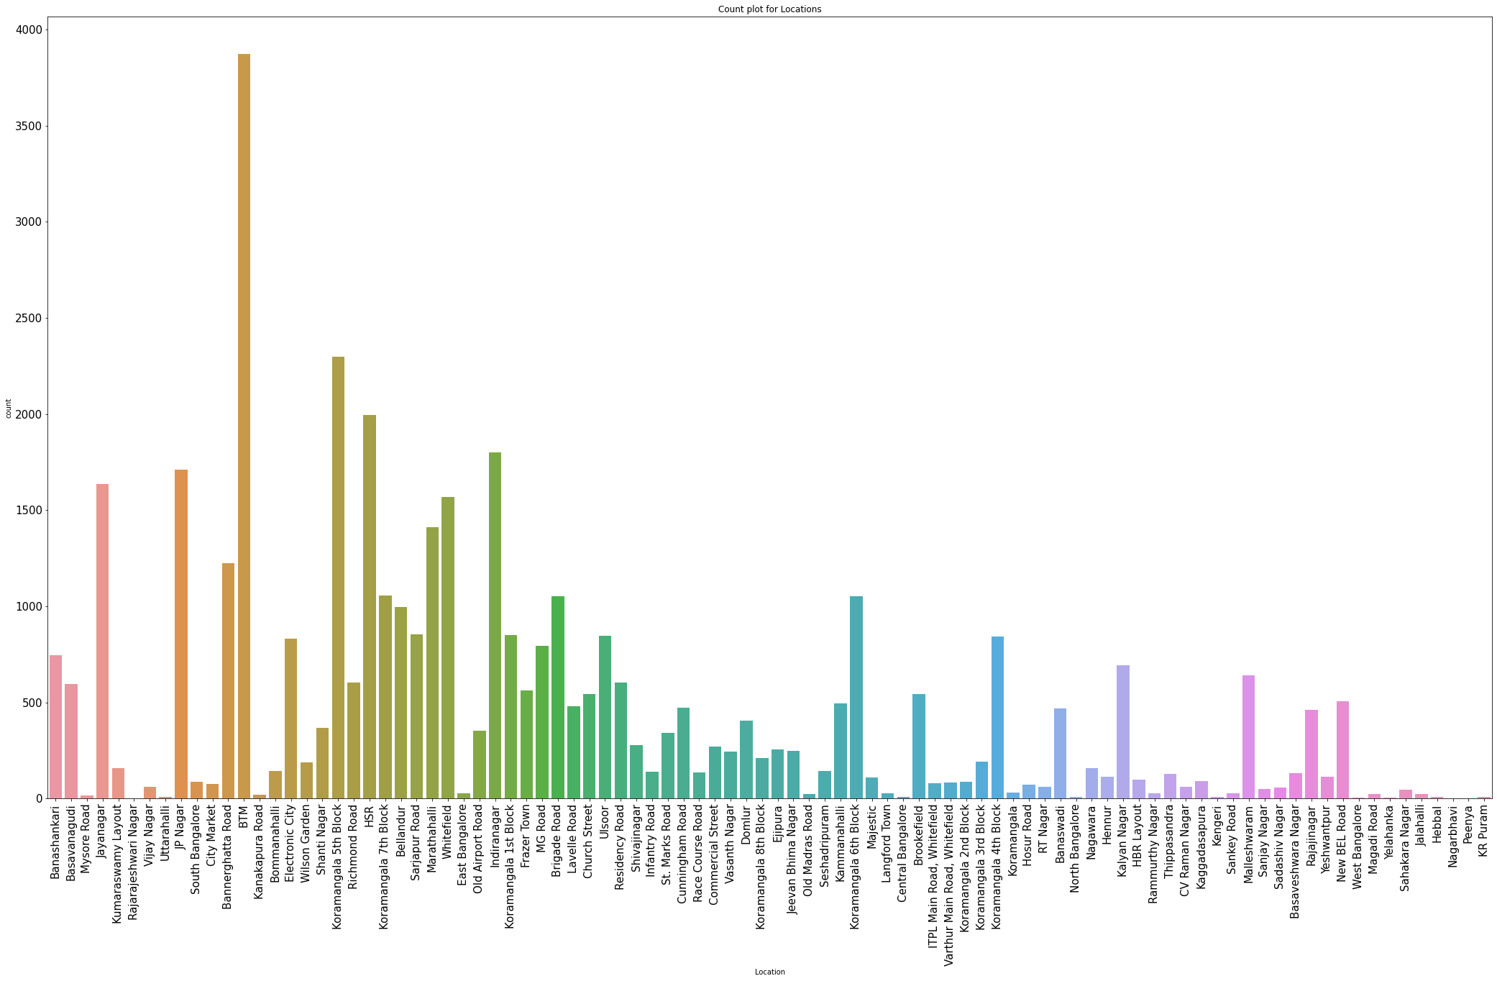
DATA ANALYSIS AND VISUALIZATION
Q1. Count plot of Various Locations
In this count plot, we can see maximum number of restaurants are present in BTM location followed by other locations.
So from this we come to point that if we want to open a restaurant in a location we will choose that location which is having less number of restaurants like Old Madras Road or Langford Town .

Slide 6
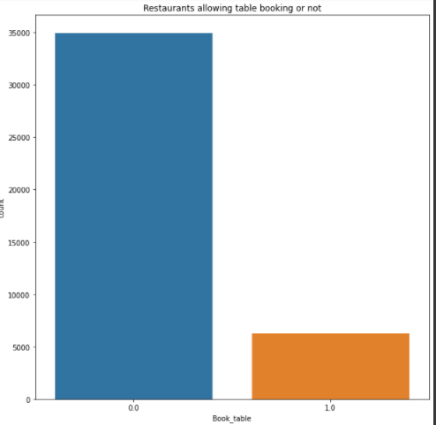
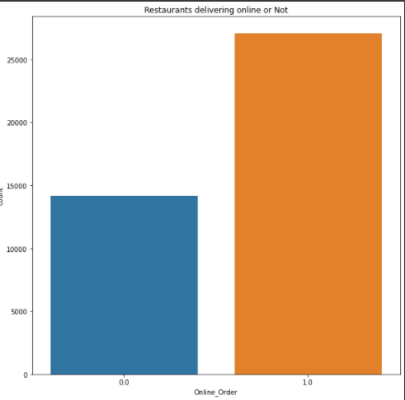
Q2. Restaurants delivering online or not
We can see here that there are more number
of restaurants that provide Delivery on Online
Order.
Q3. Restaurants allowing table booking or not
According to this graph, we can see there are less reataurants that provide online table booking.

Slide 7
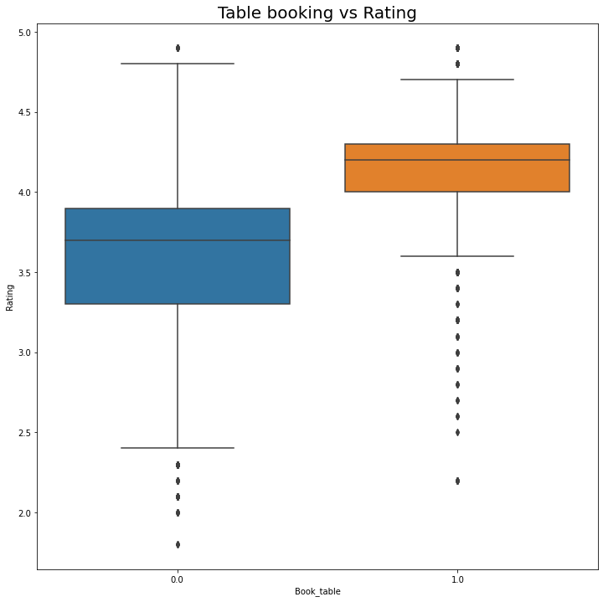
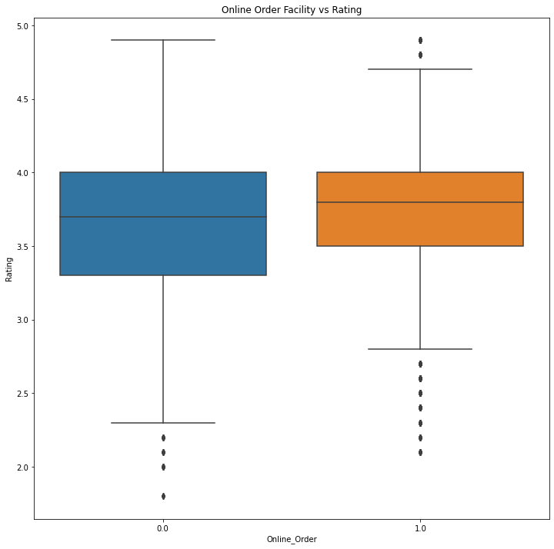
Q4. Visualizing Online Order Vs. Rating
Here, we can analyze that the restaurants that are having
online order facility ,their rating is lower than the restaurants
that are not having online order facility. Maximum rating for
restaurants with online order facility is 4.7 and that for not
having facility is 4.9.
Q5. Visualizing Table Booking Vs Rating
(1.0=Yes,0.0=No)Restaurants having book
table facility, their average rating is lower
than that who are not having the facility.

Slide 8
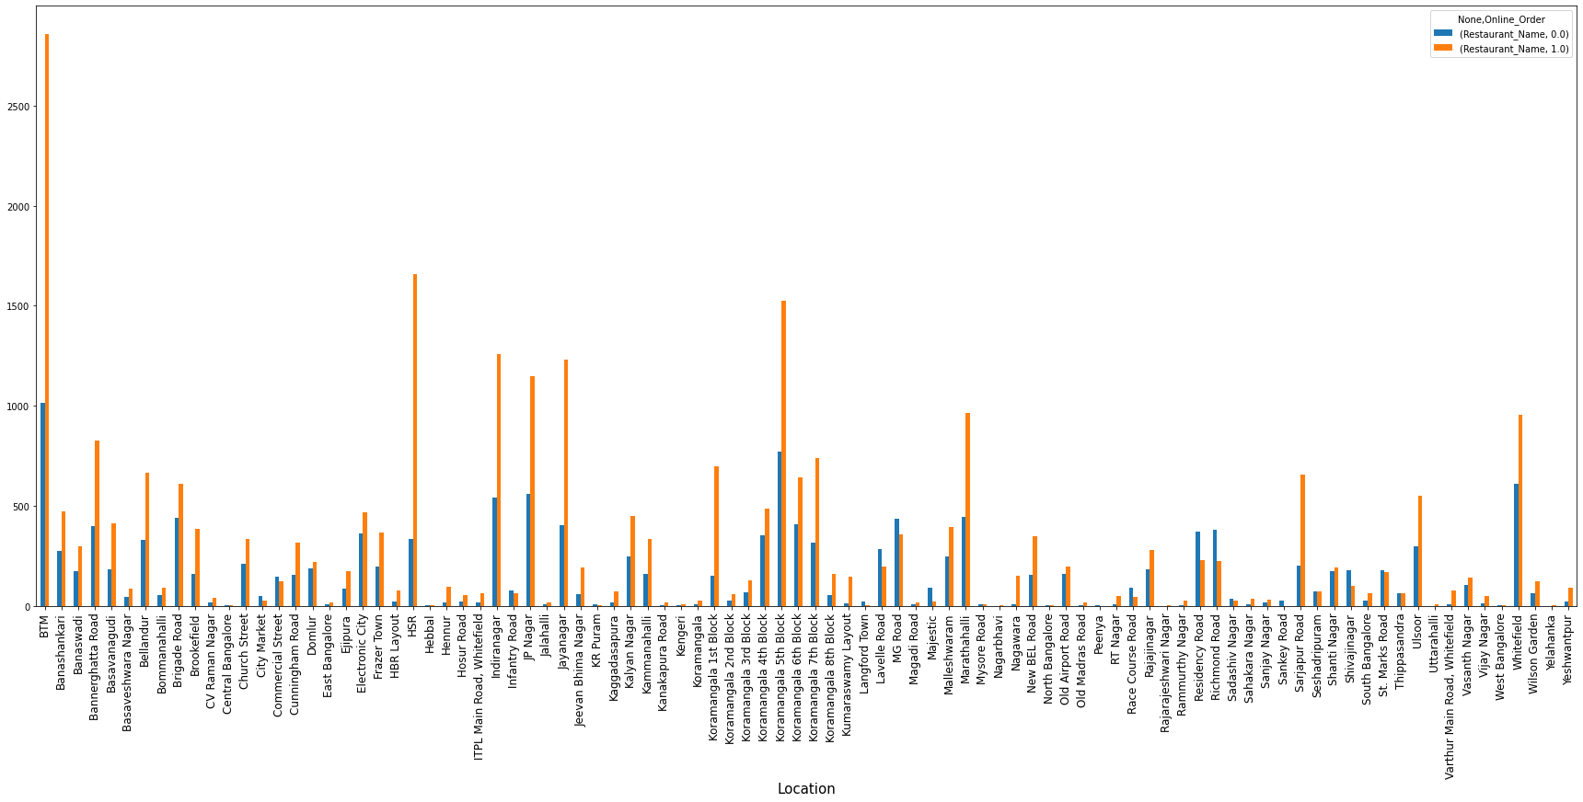
Q6. Visualizing Online Order Facility, Location Wise
(orange=yes,blue=no) In BTM orange line is highest i.e. there are many restaurants that provide online facility. But, in Location like Kanakapura Road or Mysore Road,etc. the blue line is smaller.

Slide 9
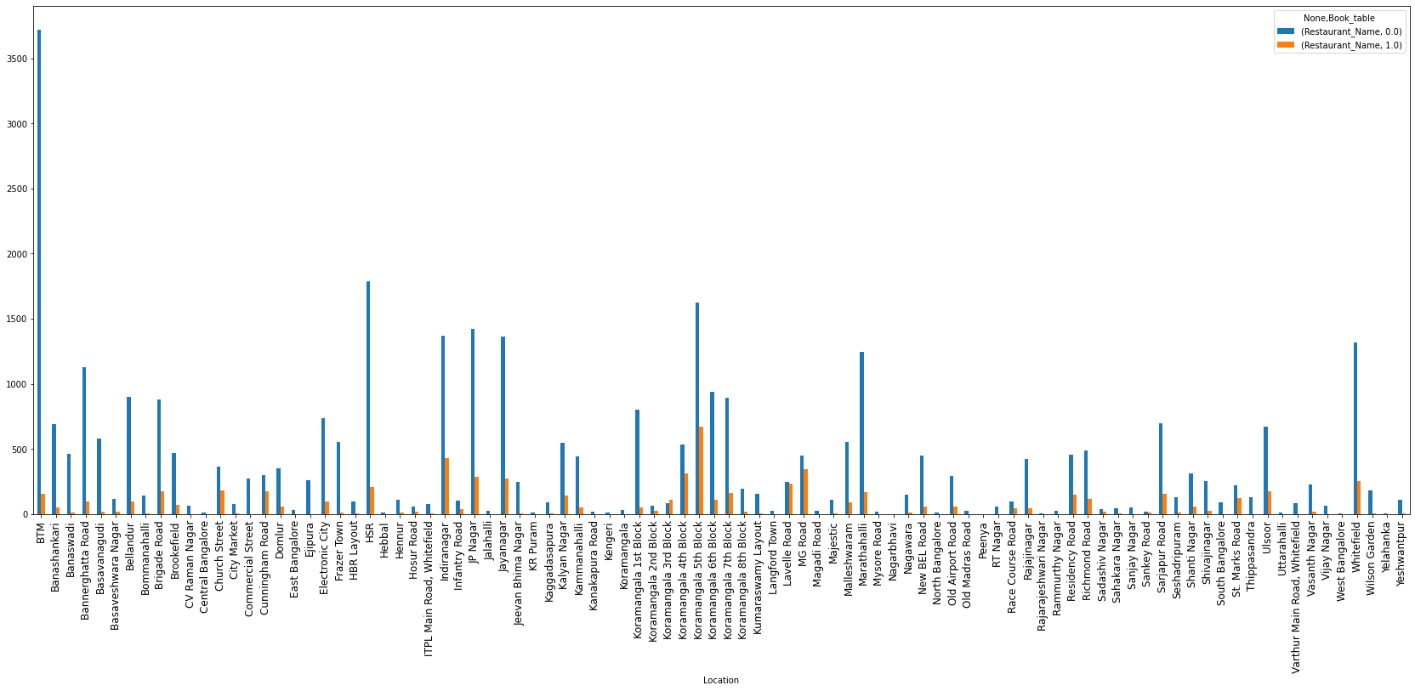
Q7. Visualizing Book Table Facility, Location Wise
According to this barplot, we can see in BTM many restaurants are those who do not provide book table, so if someone want to open restaurant he can open in BTM with book table facility. But, BTM already have more restaurants so he can try opening in HSR where there are less restaurants so business may grow.

Slide 10
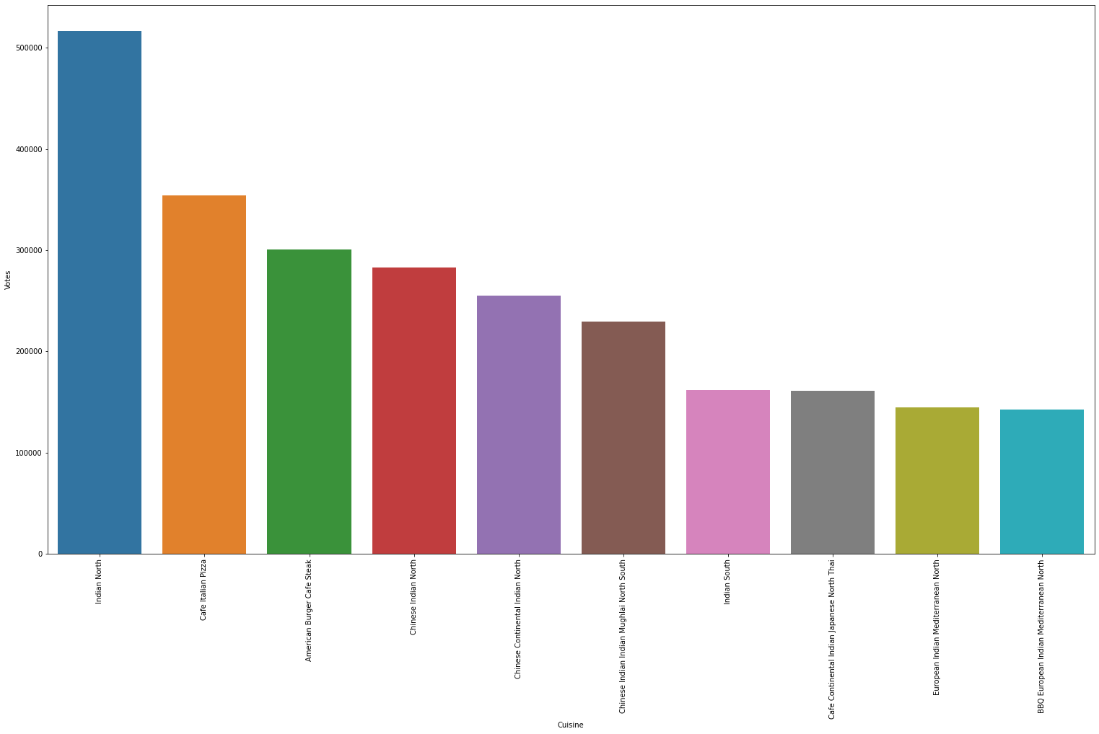
Q8. Visualizing Top Cuisines
Here, we can see North Indian Cuisine is rated highly amongst all the cuisines in Bangalore.

Slide 11
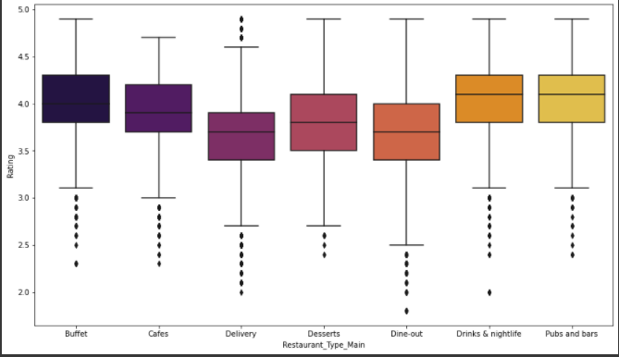
Q9. Type of Meal and Rating
We can see that maximum average rating is given to Buffet type of meal. This type of restaurant are gievn maximum rating. That means, peolpe are coming in this type of restaurant and have rated highest. And also the Delivery type of restaurant is having lowest average rating.

Slide 12
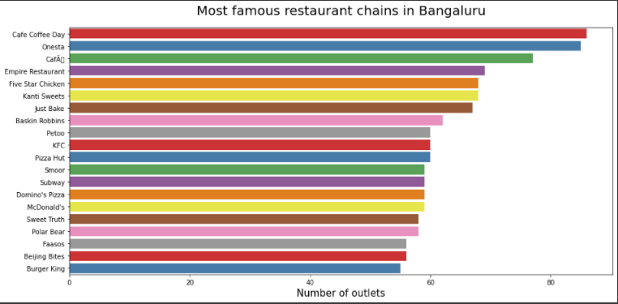
Q10. Most famous restaurant chains in Bangalore
In Bangalore, most famous restaurant chain is CCD (Cafe Coffee Day).

Slide 13
CONCLUSIONS
After all the data processing and analysis, we can get this following conclusion: There are 51717 restaurants registered on Zomato Apps based in Bangalore. More than 3500 restaurants are located in BTM which is highest amongst the all in Bangalore.
There are high number of restaurants that provide Online Order facility comparatively there are less number of restaurants that provide booking table facility.
Also North Indian is the cuisine most famous in Bangalore. Restaurants which provide Buffet system are high rated .
If we look for most famous restaurant chain in Bangalore, Cafe Coffee Day (CCD) stands at the top.

Slide 14
REFERENCES
[1] Blog on Zomato Data Analysis By Chandresh~ https://chandresh.me/Zomato_data-Analysis/
[2] From some Github repositories.
[3] Also from Kaggle notebooks.

Slide 15
THANK YOU

